Slide 1

Supporting the Wellbeing of Practice Staff
Dr Vasumathy Sivarajasingam
GP Partner at Hillview Surgery, West London.
Clinical Research Fellow at Self-Care Academic Research Unit
Department of Primary Care & Public​ Health, Imperial College London.

Slide 2
What does ‘staff wellbeing’ mean?
What is its impact on staff and patient care?
How can we support our staff’s wellbeing?

Slide 3
The NHS People Plan 2020/21
Looking after our people
Belonging in the NHS
New ways of working and delivering care
Growing for the future
https://www.england.nhs.uk/ournhspeople/

Slide 4
Wellbeing Conversations
“From September 2020, every member of the NHS should have a health and wellbeing conversation and develop a personalised plan. These conversations may fit within an appraisal, job plan or one-to-one line management discussion, and should be reviewed at least annually. As part of this conversation, line managers will be expected to discuss the individual’s health and wellbeing, and any flexible working requirements, as well as equality, diversity and inclusion.”
The NHS People Plan 2020-21

Slide 5
Evidence
“60% of employees feel more motivated and more likely to recommend their organization as a good place to work if their employer took action to support mental wellbeing”¹
“Healthy employees are more committed and committed employees are healthier”²
“Strong correlation between high staff wellbeing and engagement levels – mutually reinforcing and essential for improved performance” ²
https://www.mind.org.uk/news-campaigns/news/work-is-biggest-cause-of-stress-in-peoples-lives/
https://engageforsuccess.org/wp-content/uploads/2015/09/wellbeing-and-engagement-04June2014-Final.pdf

Slide 6
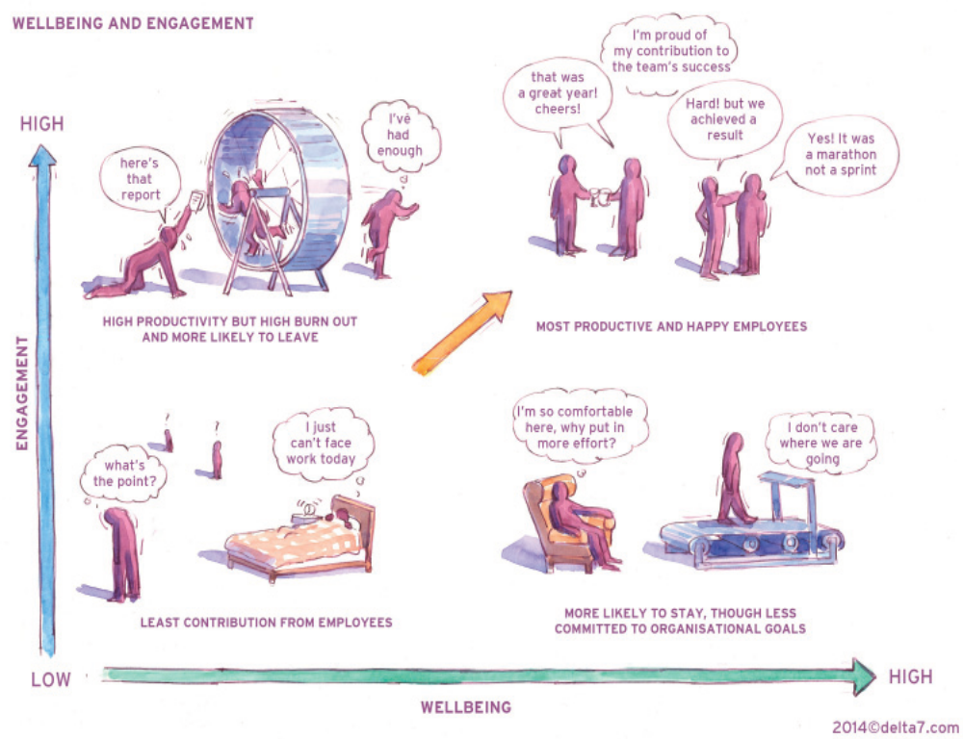
A Model For Sustainable Wellbeing & Engagement

Slide 7
Staff Interpretation of ‘Staff Wellbeing’
Autonomy
Equality
Workload
Financial reward
Morale
Safety
Health
Diversity
Staff engagement
Safe working environment
Team support
Relationship with line managers
Understanding personal circumstances

Slide 8
Practical examples & initiatives
Bringing staff wellbeing to life at Hillview Surgery

Slide 9
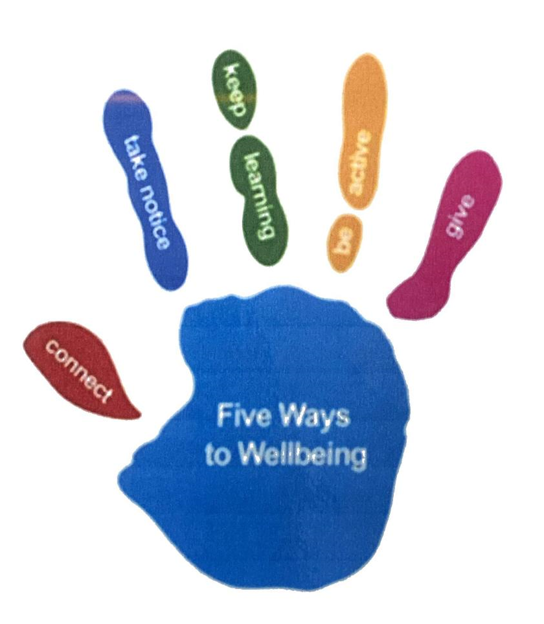
Five ways to wellbeing
neweconomics/five-ways-well-new-applications-new-ways-thinking

Slide 10
Connect...
With the people around you. With family, friends, colleagues and neighbours. At home, work, school or in your local community. Think of these as the cornerstones of your life and invest time in developing them. Building these connections will support and enrich you every day.

Slide 11
Connect…
Ideas we recommended to our staff
Staff meetings by Zoom
‘Hillcrew’ WhatsApp group
Share and openly acknowledge any successes/or new initiatives
Ask how someone’s weekend was and really listen when they tell you
Put five minutes aside to find out how someone really is

Slide 12
Be Active…
Go for a walk or run. Step outside. Cycle. Play a game. Garden. Dance. Exercising makes you feel good. Most importantly, discover a physical activity you enjoy and that suits your level of mobility and fitness.

Slide 13
Be Active …
Ideas we recommended to our staff
“Go Active” initiative
Option of wearing appropriate trainers/comfortable shoes to work
Take the stairs not the lift
Go for a walk at lunchtime
Walk into work - perhaps with a colleague – so they can ‘connect’ as well
Do some ‘easy exercise’, like stretching, before leaving for work
‘Deskercise’
Walking for health
Kickstart your health
Cycle to work scheme

Slide 14
Take Notice…
Be curious. Catch sight of the beautiful. Remark on the unusual. Notice the changing seasons. Savour the moment, whether you are walking to work, eating lunch or talking to friends. Be aware of the world around you and what you are feeling. Reflecting on your experiences will help you appreciate what matters to you.

Slide 15
Take Notice…
Ideas we recommended to our staff
Take a different route on your journey to or from work
Have a ‘clear the clutter’ day
Take notice of how your colleagues are feeling or acting

Slide 16
Keep Learning…
Try something new. Rediscover an old interest. Sign up for that course. Take on a different responsibility at work. Fix a bike. Learn to play an instrument or how to cook your favourite food. Set a challenge you will enjoy achieving. Learning new things will make you more confident as well as being fun.

Slide 17
Keep Learning...
Ideas we recommended to our staff
Find out something about your colleagues
Sign up for an online class
Set up a book club
Do a crossword or Sudoku
Research something you’ve always wondered about and share with colleagues

Slide 18
Give…
Look out, as well as in. Seeing yourself, and your happiness, linked to the wider community can be incredibly rewarding and creates connections with the people around you.

Slide 19
Give…
Ideas we recommended to our staff
Do something nice for a friend, or a stranger
Thank someone
Smile
Volunteer your time
Join a community group

Slide 20
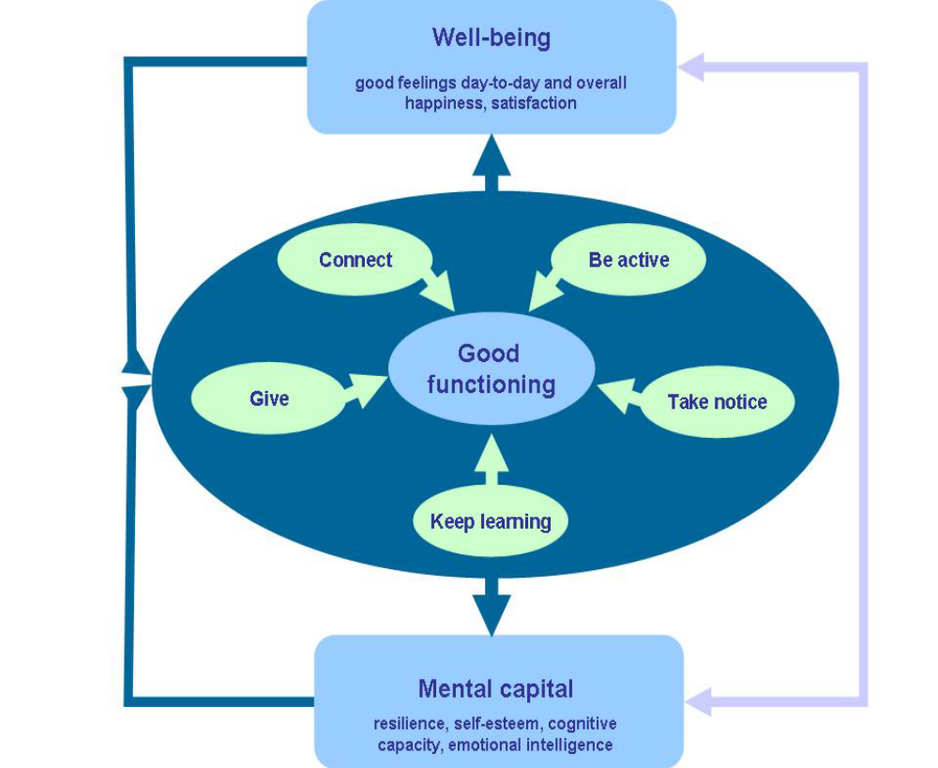
A model describing how the set of actions operates to enhance wellbeing
https://neweconomics.org/uploads/files/8984c5089d5c2285ee_t4m6bhqq5.pdf

Slide 21
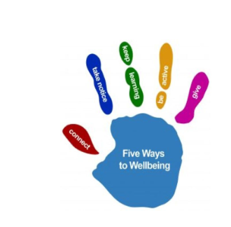

Holistic Staff Wellbeing
Mentally and Physically Keep Active
“Go Active”
Work-life Balance
Team working
Improve Communication/Digital
“New normal”
Five ways to wellbeing

Slide 22


Domestic Violence and Abuse Awareness
Help improve identifying DVA victims
  Patients (Flowchart for responding to Domestic Abuse)
  Staff (Domestic Violence & Abuse Policy)
Raise awareness in our society
https://www.hillviewsurgery.nhs.uk/domestic-violence-and-abuse/

Slide 23



Hillview is Going Greener
Healthy People and Healthy Planet
Climate emergency is a Health emergency
Green impact for health Toolkit (July 2020)
hillview-surgery-going-greener
Working towards the Gold certificate

Slide 24
Share Information Across Practice Team
Staff/practice meetings
Informal meetings
Email
Weekly communication eg ‘Head’s up’ email
What’s App
Posters in the staffroom/kitchen
Staff handbook

Slide 25
Practical Ideas to Support Staff Wellbeing

Slide 26
Practical Ideas to Support Staff Wellbeing
Embed staff wellbeing from the top - ‘Role models’
Set up dedicated teams - distribute the responsibility throughout the team
    Mental health lead/champions
    Domestic abuse champions
In cooperate ‘staff wellbeing’ within our working lives
    Appraisal
    Performance review meeting
    Informal meetings
    Day to day
    Opportunistically

Slide 27
Practical Ideas to Support Staff Wellbeing
Engage and empower staff - promote good relationships between staff
    Design activities (social events, exercise classes, creative groups)
    Set up staff social groups
    Involving staff in dialogue and decision-making
    Improve their knowledge & skills
      Social prescribing course
      Mental health wellbeing course

Slide 28
Practical Ideas to Support Staff Wellbeing
Implement and Practice Communication Strategies
    Create a culture of openness - be mindful of the language we use
    Kindness
    Tolerance
    Respect
    Harmony
    Develop constructive criticism
    Encourage individuals to communicate their needs and concerns

Slide 29
Practical Ideas to Support Staff Wellbeing
Signpost Staff to Supportive Services/Resources
    The Free "Headspace Plus for NHS Staff"
    Health and Wellbeing Programmes
    NHS England Better Health campaign
    "Health Assured" Employee assistance programme
    My Healthy Advantage app
    Health and Wellbeing Champion
    https://portal.e-lfh.org.uk/

Slide 30
Practical Ideas to Support Staff Wellbeing
Create a supportive environment
    Line manager/supervisor/mentor
      Work-life balance
      Flexibility
      Workload
      Accountability
      Being Resilient
    Protected breaks ‘coffee breaks’
    ‘Safe Space’ (dedicated physical space within practice where staff can take time out)

Slide 31
Practical Ideas to Support Staff Wellbeing
Have Clear Policies and Procedures/HR process
    Staff wellbeing policy (living document, addressing the needs of the staff)
    Health & Safety policy
    Anti-bullying & Harassment policy
    Equality & Opportunity policy
    Recruitment & Induction
    Influence health behaviour eg smoking policy

Slide 32
Practical Ideas to Support Staff Wellbeing
Celebrate Success and Share Good News Stories - however small it seems
    Reward & recognition
Staff feedback - staff are the most valuable resource
    Annual staff wellbeing survey
    Evaluate outcomes

Slide 33
Impact Of Supporting Staff Wellbeing
Improved CQC rating
Low sickness rate
Staff development
Less patient complaints
High quality patients care
Improved performance/ productivity
Retention of staff
Satisfied patients
Healthier population
Openness
Develop a healthy, motivated workforce
Staff morale – ‘feel good factor’
Staff satisfaction
Positive health and safety culture

Slide 34
Look after ourselves
Sustaining Wellbeing with Seven Daily Habits
Learn something new every day
Use gratitude daily
Commit to working on our goals every day, without excuses
Move every day - 30 minutes of daily physical exercise
Practice deep breathing
Engage in a creative outlet that brings joy
Teach ourselves to ‘think on purpose’
sustaining-wellbeing-with-seven-daily-habits

Slide 35
QI Activities
Prescribing behaviours
    promoting a switch to greener asthma inhalers
Procurement and consumption patterns
    reducing paper use and purchasing recycled paper
Use of online access by patients
    eConsult
    askmyGP
Staff and patient travel patterns
    reducing the length and frequency of journeys
    using more sustainable transport modes
    Greenerpractice

Slide 36
Thank You

